Slide 1
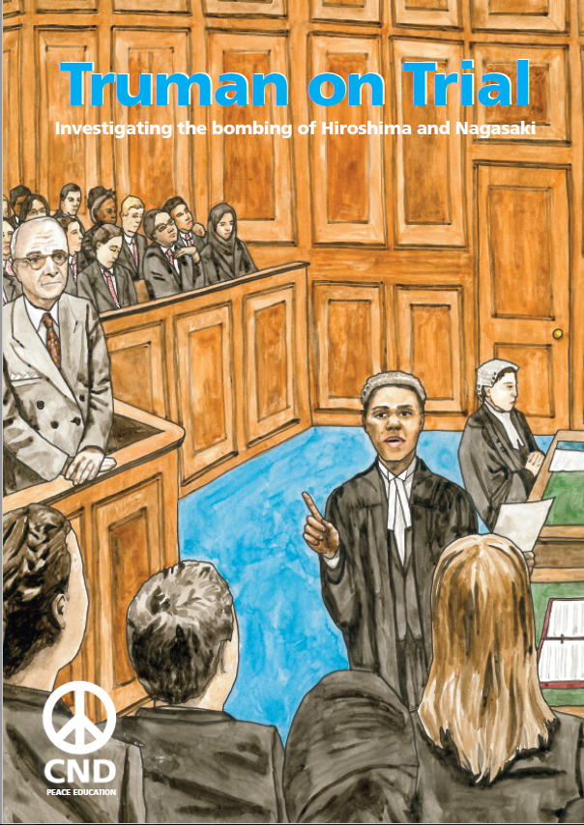
Lesson 2:
The trial

Slide 2
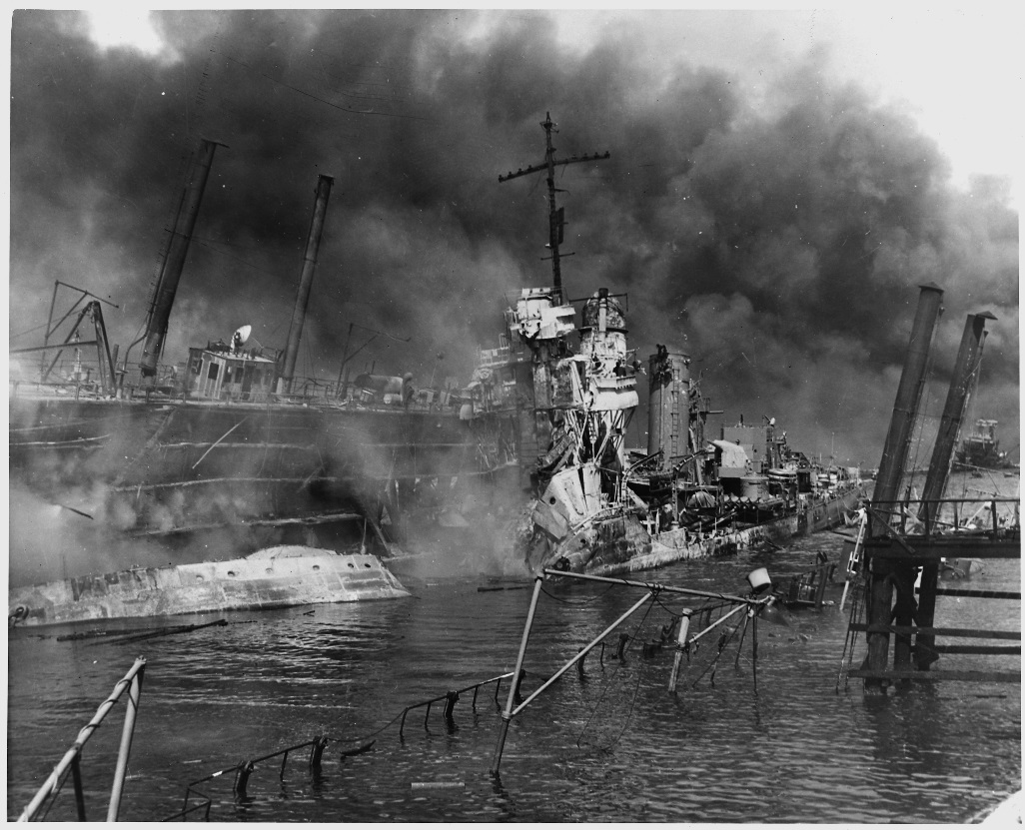
7th December 1941: Japan attacks Pearl Harbour (Hawaii). It’s a surprise attack that destroys lots of US military ships and planes, and kills over 2000 Americans. The USA entered the Second World War the next day.
US National Archives
Notes:
.

Slide 3
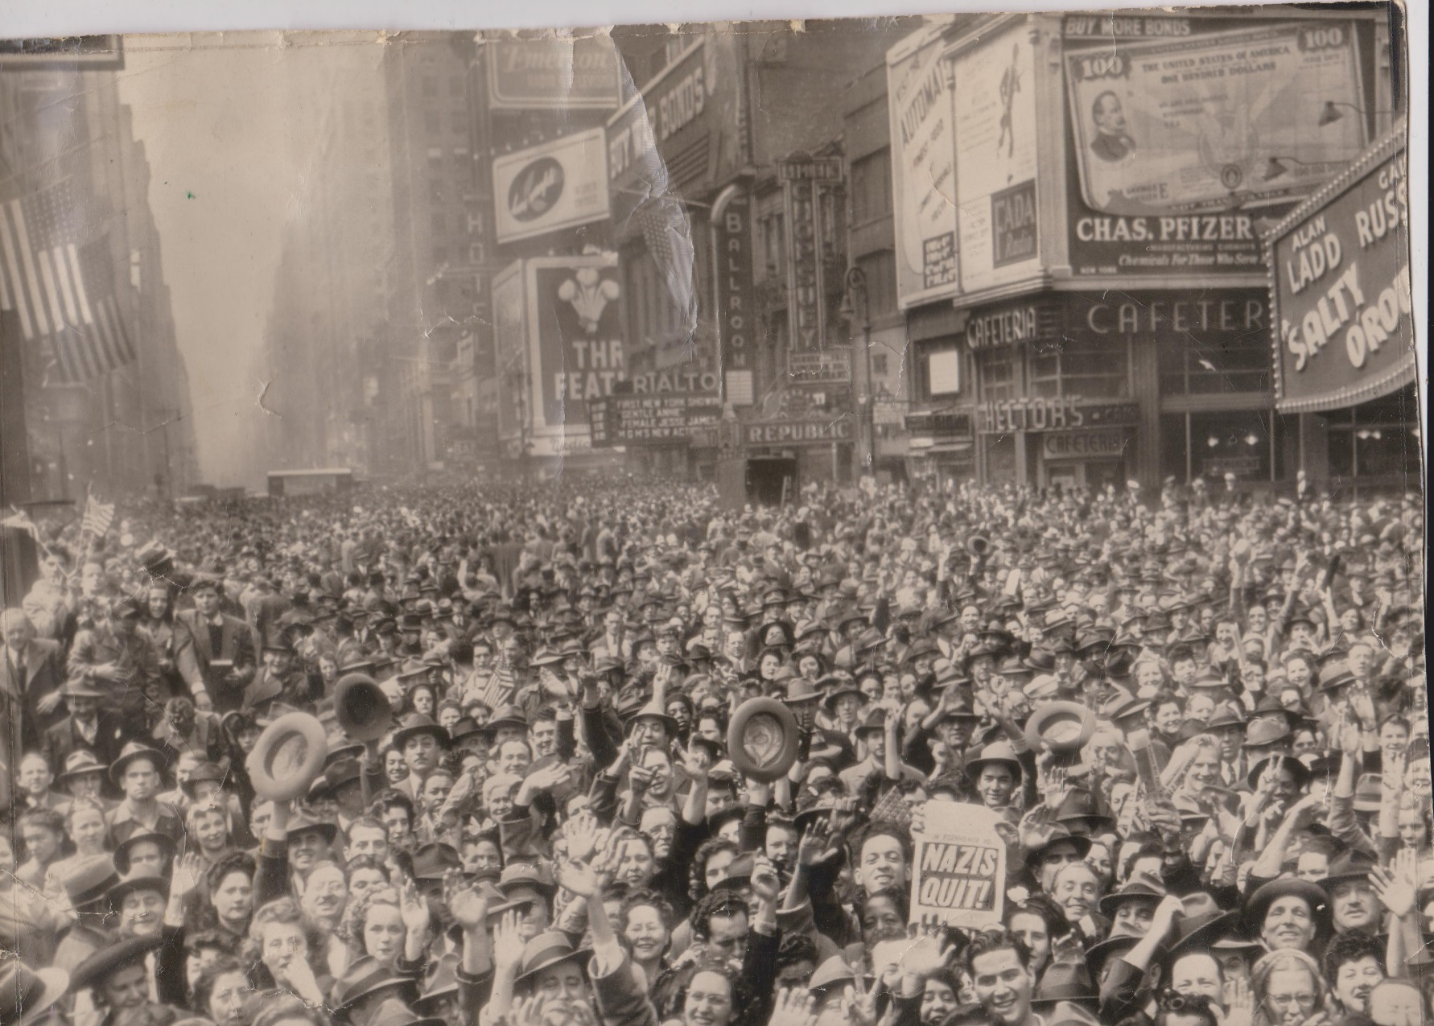
8th May 1945: Nazi Germany surrenders to the Allied Powers (Britain, USA, USSR, China, and others). This is known as Victory in Europe (VE) Day.
Robert Huffstutter; https://creativecommons.org/licenses/by-nc-sa/2.0/legalcode

Slide 4
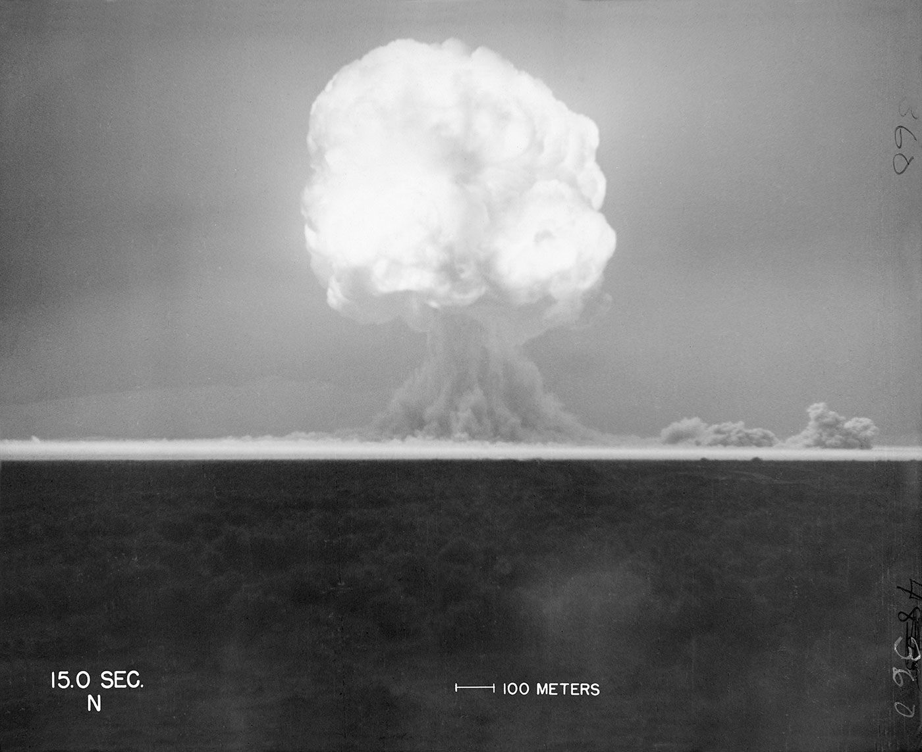
16th July 1945: The United States tests the first ever atomic bomb.
trinityremembered.com

Slide 5
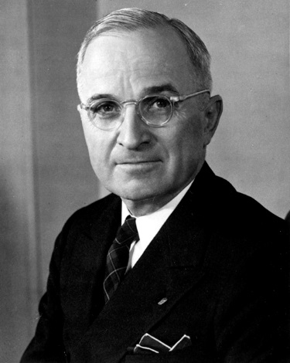
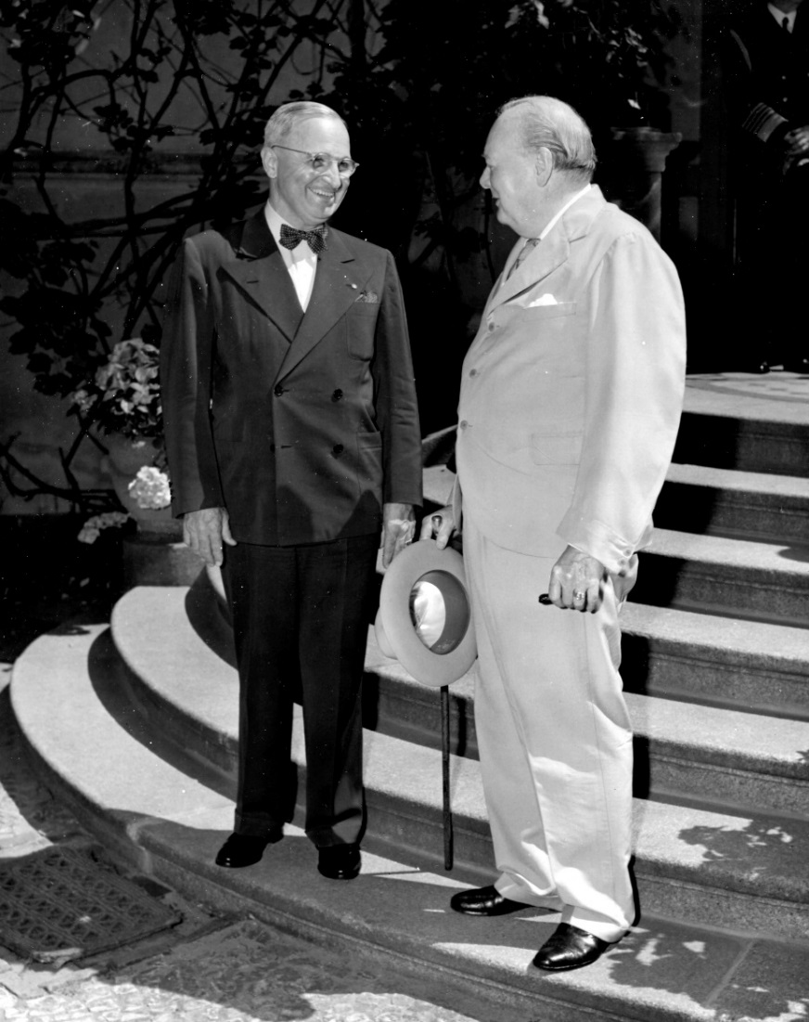
25th July 1945: President Truman gives the order to drop the atomic bomb on Japan (Winston Churchill had given Britain’s consent on 2nd July)
Lord Mariser, https://creativecommons.org/licenses/by-sa/2.0/legalcode
Harry Kidd ; https://creativecommons.org/licenses/by-nc-sa/2.0/legalcode

Slide 6
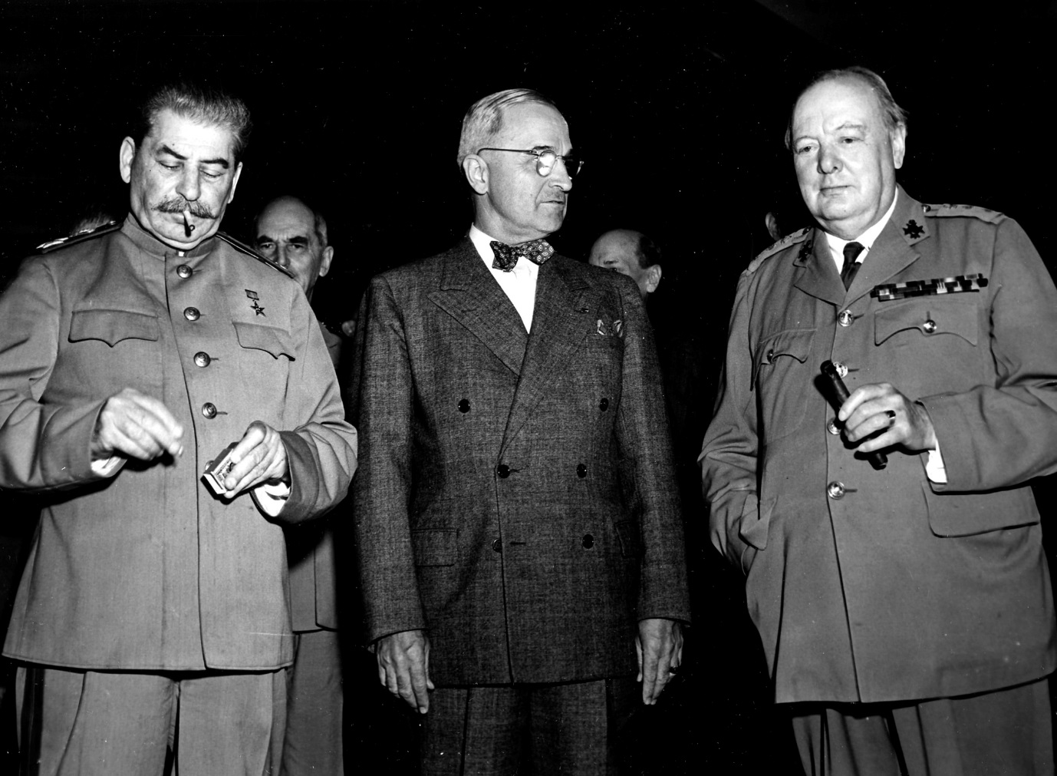
26th July 1945: Truman, Churchill and Chiang Kai-shek issue the ‘Potsdam Declaration’ to Japan, which finished with the words:
‘We call upon the government of Japan to proclaim now the unconditional surrender of all Japanese armed forces... The alternative for Japan is prompt and utter destruction.’
HarryKidd ; https://creativecommons.org/licenses/by-nc-sa/2.0/legalcode

Slide 7
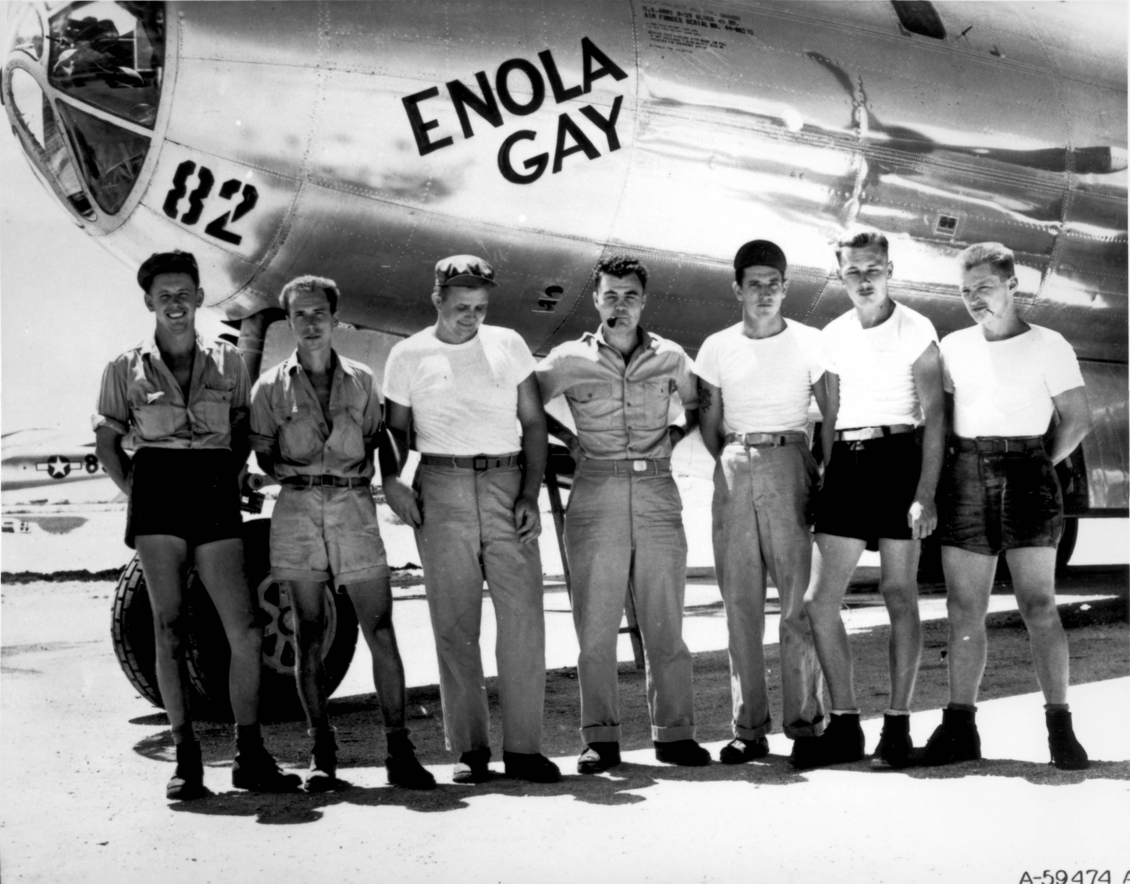
Public domain

Slide 8
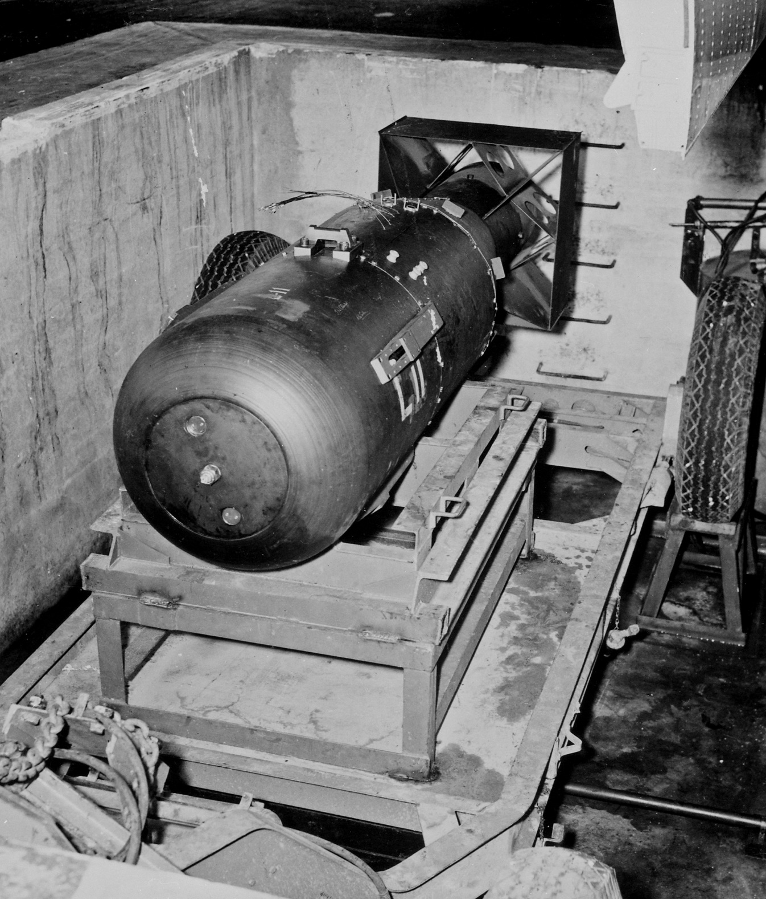
James Vaughan ; https://creativecommons.org/licenses/by-sa/2.0/legalcode

Slide 9
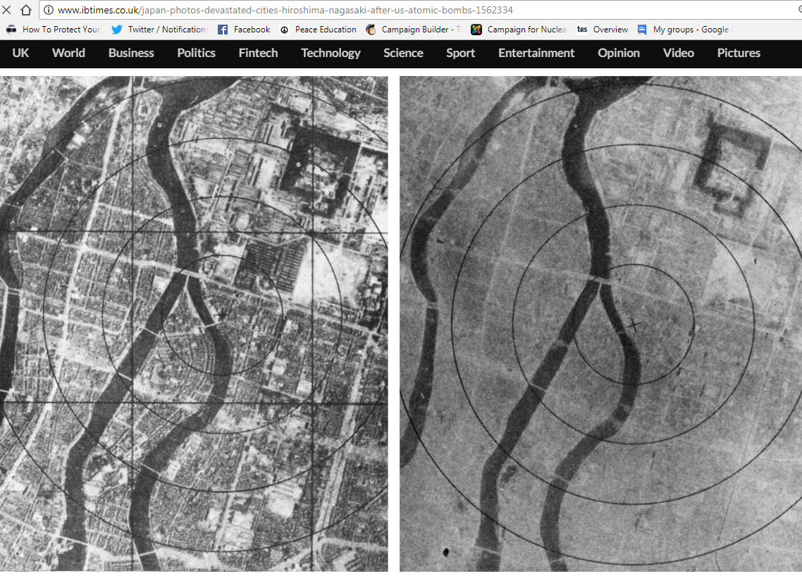
6th August 1945: The atomic bomb is dropped on Hiroshima

Slide 10
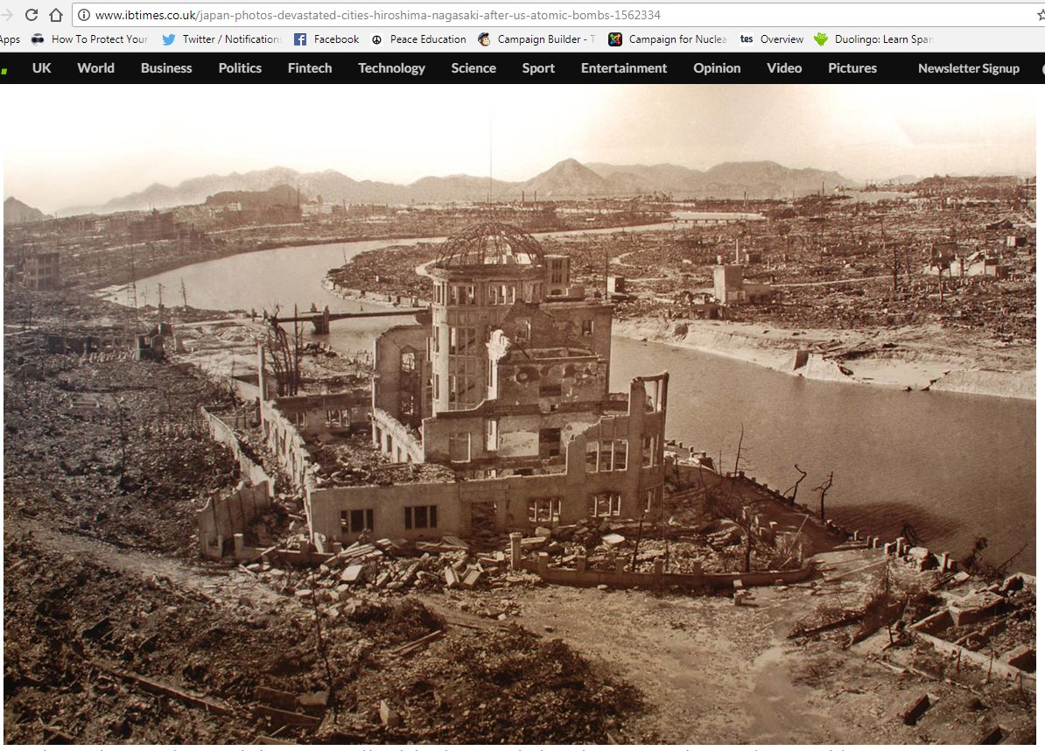

Slide 11
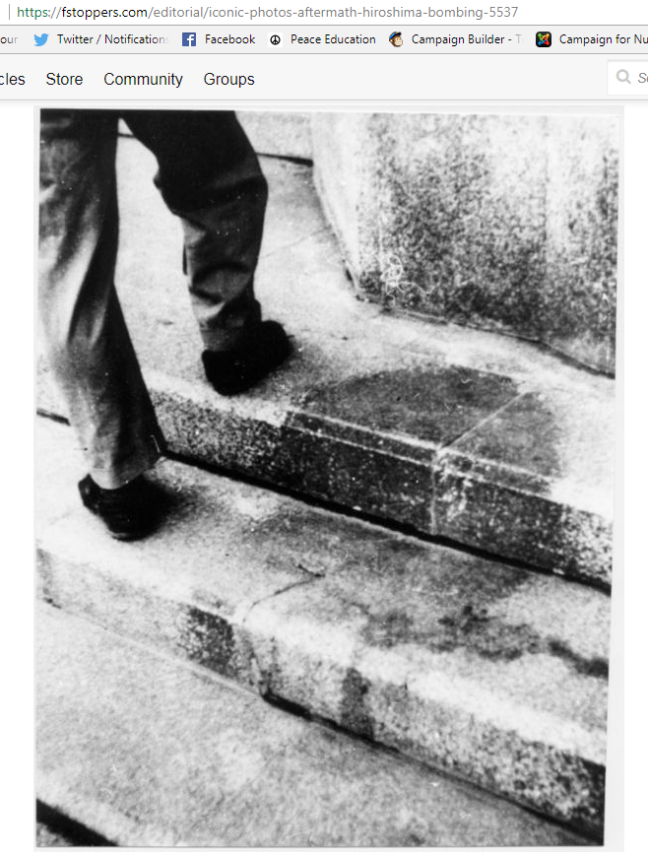

Slide 12
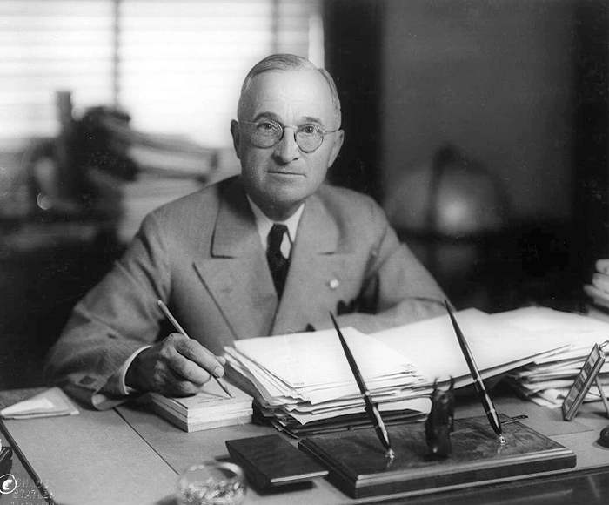
6th August 1945: President Truman gives a statement promising further bombs if Japan doesn’t surrender
Matthew Yglesias ;
https://creativecommons.org/licenses/by-sa/2.0/legalcode

Slide 13
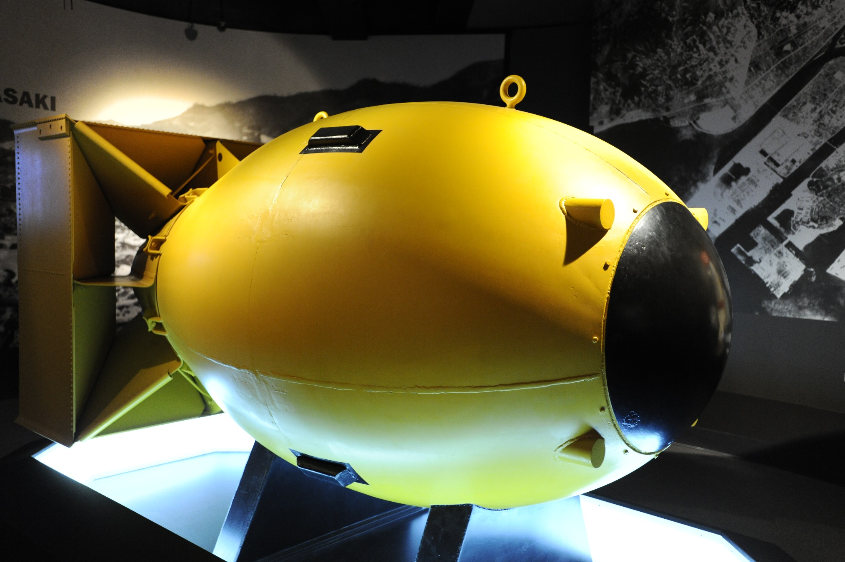
Ed Uthman ; https://creativecommons.org/licenses/by-sa/2.0/legalcode

Slide 14
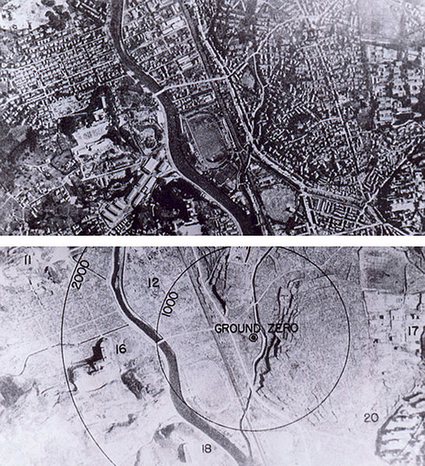
9th August 1945: The bomb is dropped on Nagasaki
Wikimedia Commons

Slide 15
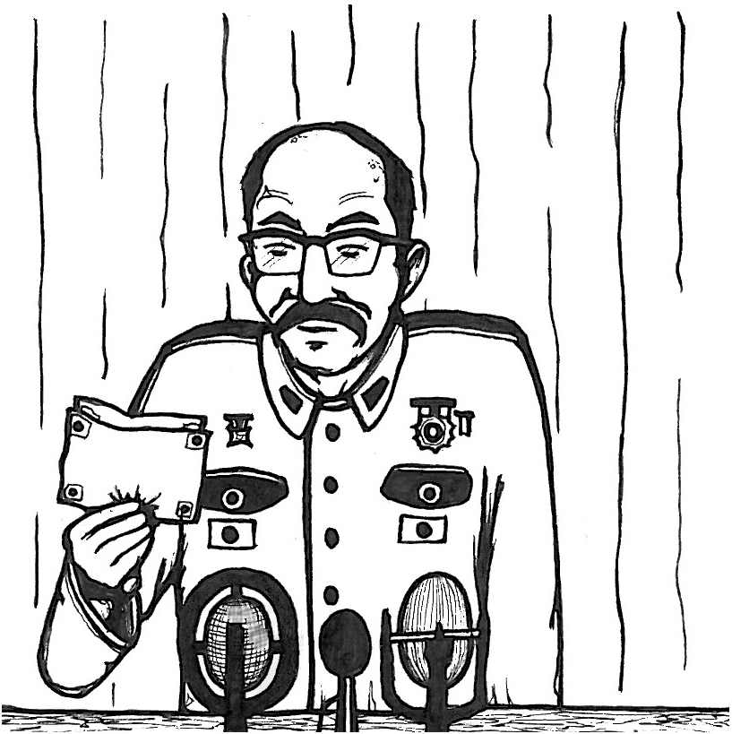
2 September 1945: Japan formally surrenders. This is the end of the Second World War.

Slide 16
What are the arguments for the bombings?
Saved lives: it ended the war ASAP, saving lives overall because the USA didn’t have to invade Japan
Revenge for Pearl Harbour
Once the atomic bomb was developed, it was always going to be used
Notes:
.

Slide 17
What are the arguments against the bombings?
Immoral: Killed 185,000-340,000 - mostly civilians
Surrender was possible: The US knew that some of the Japanese government wanted to surrender
More about sending a message to the Soviet Union
It was to test a nuclear bomb for real
Notes:
.

Slide 18
Your Task:
Stage a mock criminal trial to decide whether Truman was justified or unjustified in ordering the bombings.

Slide 19
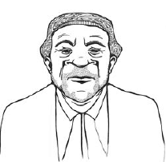
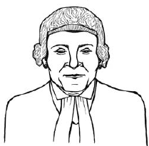
Barristers
What are the two sides called?
Before the trial you will:
Gather information from your three witnesses (filling in sheet)
Prepare a short opening speech (fill in sheet; you could also include quotes from the extra sources)
During the trial you will:
Question your witnesses, and the other side’s witnesses
Give a closing speech to sum up your arguments (you can improvise this, based on what’s said in the trial)

Slide 20
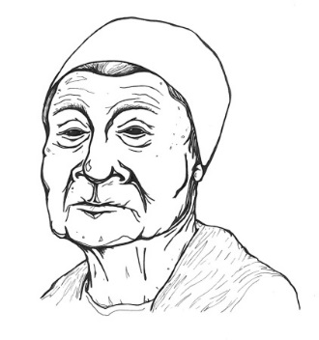
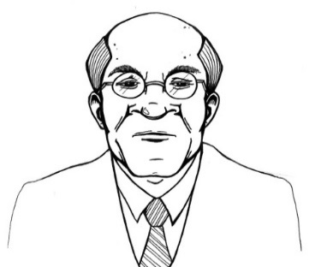
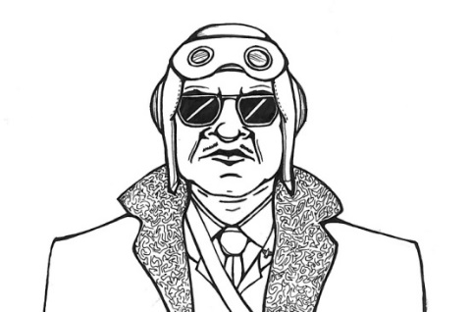
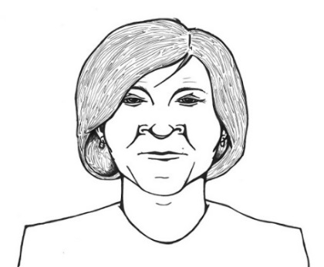

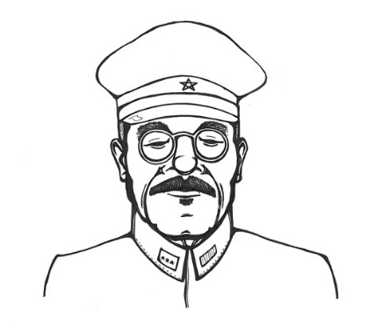
Witnesses
Before the trial you will: Fill in your sheet, and then answer questions from the barrister(s) when they come round.
During the trial you will: Give evidence to the court, and fill in the new sheet with information – and your opinions - on the other witnesses.
After the trial you will: Become the jury, to make a verdict.
Nagasaki survivor
Truman’s advisor
Bomber pilot
Japanese Army General
American civilian
Nuclear Scientist

Slide 21
Your verdict:
Now, as the jury, vote on whether Truman was justified or unjustified to have the atomic bombs dropped.

